Slide 1




BRAINSTORMERS
HACKTOBERFEST 1.0

Slide 2


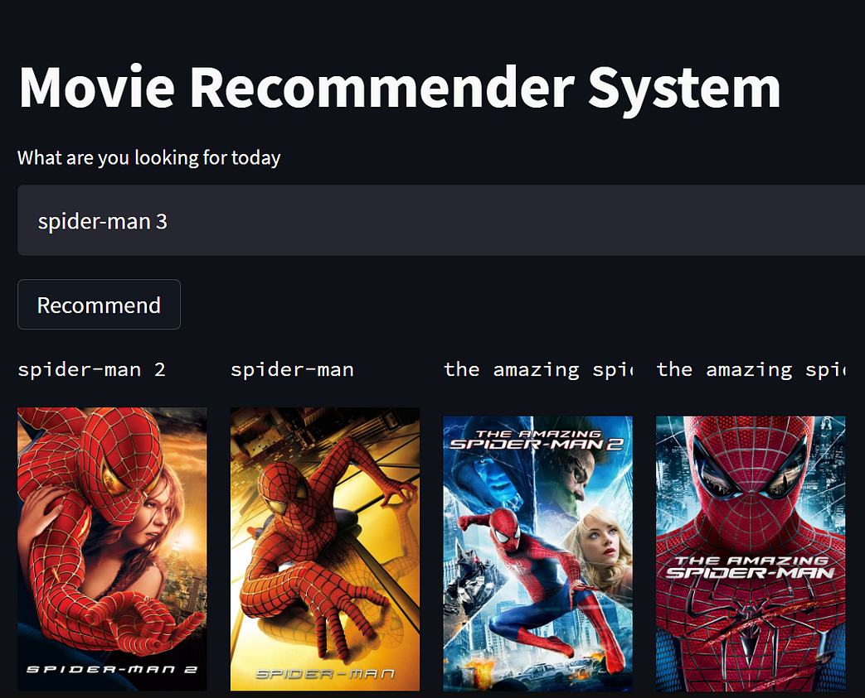


Movie Recommender System
It aims to recommend movies to the viewers based on their interests.
It enhances a user's movie watching experience by providing them with the most suitable options.
Netflix uses NRE recommendation system.
The NRE is composed of multiple algorithms that filter content based on a user's profile. The system filters over 3,000+ titles using 1,300 recommendation clusters all based on an individual user's preferences

Slide 3




Solution
Our business strategy is to create a profitable movie recommendation platform that offers personalized movie suggestions to users.
A successful movie recommendation system should balance the technical aspects of recommendation algorithms with a solid business strategy that focuses on user satisfaction, growth, and profitability..

Slide 4



Key Features and Functionality
Personalized Recommendations: The system analyzes your viewing history and preferences to provide movie suggestions tailored to your taste.
Multi-Genre Suggestions: Users can explore movies across various genres, ensuring a wide range of options to choose from.
Content Discovery: Watch trailers, behind-the-scenes content, and get detailed information about the movies.
Search and Filters: Easily search for specific movies or use filters to refine results by criteria like release year, cast, or director.
Watchlist: Create a watchlist to save movies you want to watch later, making it easy to keep track of your interests.

Slide 5


Social Impact
Social impact objectives for a movie recommendation system include promoting diverse content and reducing biases in recommendations, while also emphasizing user privacy and informed choices.
Track user engagement with diverse movie recommendations, monitoring user reviews and ratings.
Assess system performance by measuring the reduction of algorithmic biases and user data privacy compliance.
Offer subscription tiers that fund independent films and provide content labels to help users make informed choices, while implementing strict privacy policies to safeguard user data.

Slide 6



Revenue Model
Subscription model: A monthly or annual fee for premium access to the recommendation service. Subscribers get benefits like ad-free usage, early access to new features, and exclusive content.
Pay-Per-View or Rental:
We allow users to rent or purchase movies directly through the platform, earning a commission on each transaction.

Slide 7



Technologies Used
OUR TEAM UTILIZED A VARIETY OF TECHNOLOGIES INCLUDING PROGRAMMING LANGUAGES LIKE HTML, CSS, JAVA SCRIPT

Slide 8

The Team
Yepuri Harsha Vardhan
Sai Pranathi Kothapalli
Shanmukha Trisha Sunkara

Slide 9


Thank You
HACKTOBER FEST

